Slide 1
Procedural Programming

Slide 2
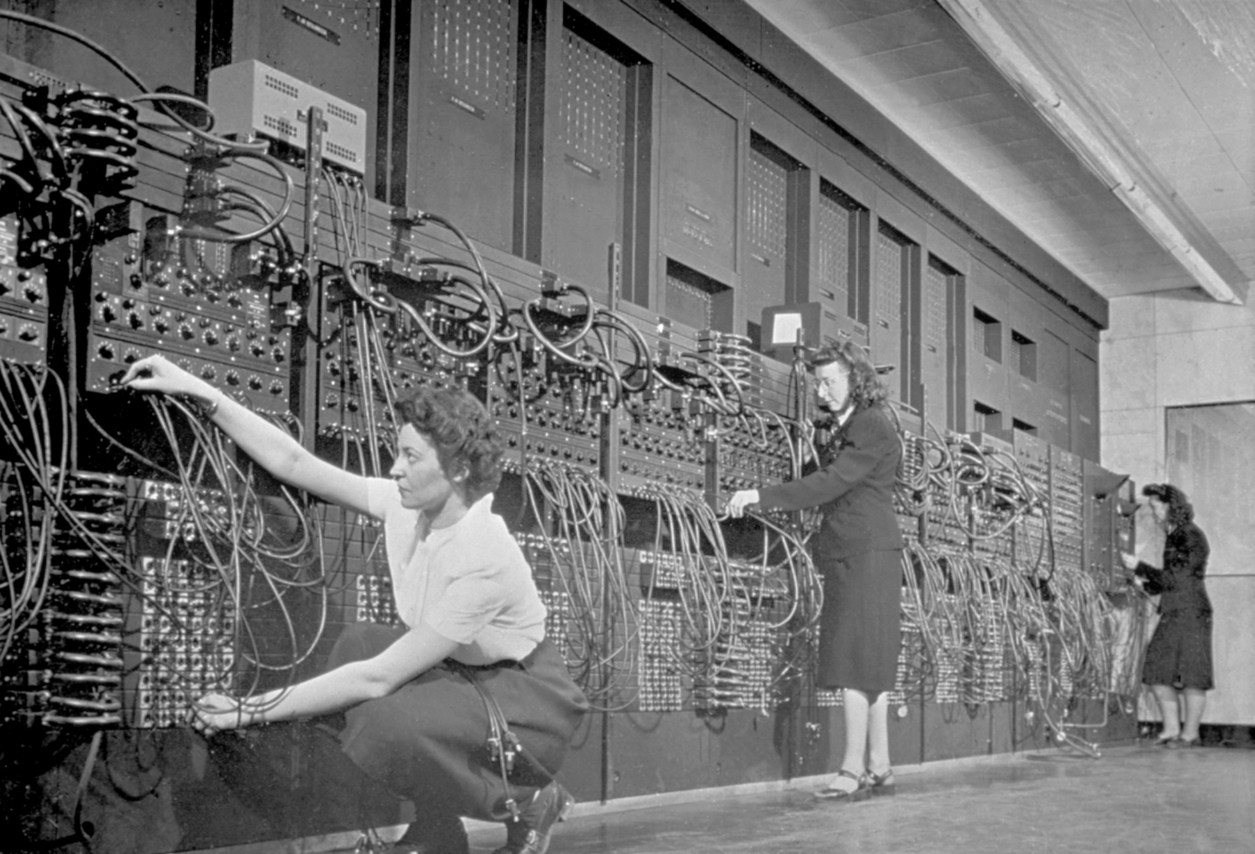
From the beginning, programming was hard
Programming was done, at first, by re-wiring.

Slide 3
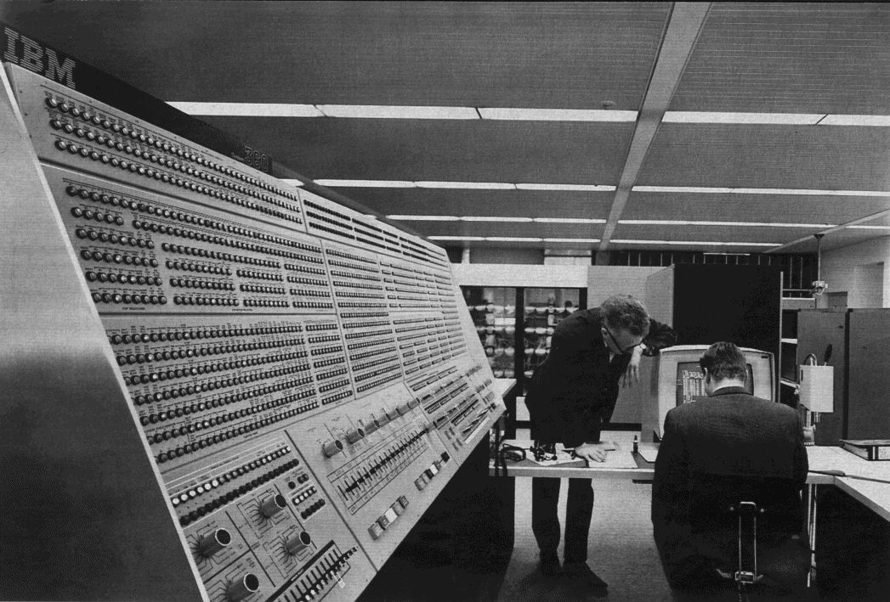
Machine Language
With the adoption of computer memory as a way to store programs, we moved to machine language.

Slide 4
Machine Language – First Generation Language
Machine language is made up of instructions, stored in bits.
1001 1100 1010 0011 (for example)
These bits might indicate that the computer should add two numbers together (stored at addresses 14 and 10) and saving them into another address (3).

Slide 5
No loops or advanced flow control
You can jump to a different instruction by comparing two values:
Is the first less than the second?
Greater than the second?
Equal?
Not Equal?
There were also no variable names – everything was by address in the computer.

Slide 6
Clearly this was difficult…
To write a program, you had to:
Understand the algorithm
Break it down to the instructions that the computer could do
Manage your resources (memory, input, output)
Deal with infinite loops
All with no debugging capability
And if the program is wrong, you have to fix and re-enter by hand!

Slide 7
Asssembly – Second Generation Language
The most pressing need (and it was done fairly quickly) was to get out of flipping switches and entering bit values.
Assembly language is a textual representation of machine language.
It is a 1-1 translation – one line of assembly is one machine language instruction.
1001 1100 1010 0011 ➔ ADD R14, R10, R3

Slide 8
Assembler
Assembly Language is the language. An assembler is the program that takes the text (ADD R14, R10, R3) and converts it into bits.
This is still slow and arduous, but easier than working in bits.
Assembly language is still used today by people who work close to the hardware!
Often game developers will do some level of high performance work in assembly.

Slide 9
Growth of computing
While assembly language was a big jump, it still presents a number of problems that started to be pressing.
Computers were getting cheaper and more of them were being made. Companies started looking at how computers could help them with handling their exploding data needs.
What they found, at first, was not an easy path.

Slide 10
Problems with working in Assembly
Assembly language is
machine (brand) specific
labor-intensive (and therefore expensive)
arduous (tedious and difficult to write long programs)
unintelligible (hard for others to read what you wrote)
highly detailed (even things we don’t care about)
hard to reuse any existing work

Slide 11
Begin the abstraction…
While the 1st and 2nd generation languages were all very tied to the machine design, the 3rd generation were far less so – they were more abstract.
By taking a step back from the hardware and writing programs based on what one wants to do, a number of the issues with assembly were addressed.

Slide 12
Procedural languages solve issues!
Assembly procedural language(s) is(are):
machine (brand) specific “portable”
labor-intensive (and therefore expensive) Quick to develop in
arduous (tedious and difficult to write long programs) Easy
unintelligible (hard for others to read what you wrote) Clear
highly detailed (even things we don’t care about) Abstract
hard to reuse any existing work Encourage reuse

Slide 13
Procedural Language Innovations
Named variables
Loops (for, while)
If
abstractions for reading/writing
Functions/Procedures/Subroutines (parameters and return values!)
Data structures (Cobol records)
Scoped variables
Enforcement of data types

Slide 14
A hint of the flavor - Fortran
In 1956, John Backus (you will hear his name later!) and his team created a language called Fortran (FORmula TRANslator).
A team at IBM spent 25 person-years to build a language designed to take scientific formulae and convert them (nearly) 100% efficiently to machine language.
Fortran is still used in scientific computing because of its high performance and wide-spread use.

Slide 15
C AREA OF A TRIANGLE - HERON'S FORMULA
C INPUT - CARD READER UNIT 5, INTEGER INPUT
C OUTPUT - LINE PRINTER UNIT 6, REAL OUTPUT
C INPUT ERROR DISPAY ERROR OUTPUT CODE 1 IN JOB CONTROL LISTING
INTEGER A,B,C
READ(5,501) A,B,C
501 FORMAT(3I5)
IF(A.EQ.0 .OR. B.EQ.0 .OR. C.EQ.0) STOP 1
S = (A + B + C) / 2.0
AREA = SQRT( S * (S - A) * (S - B) * (S - C) )
WRITE(6,601) A,B,C,AREA
601 FORMAT(4H A= ,I5,5H B= ,I5,5H C= ,I5,8H AREA= ,F10.2,12HSQUARE UNITS)
STOP
END

Slide 16
A hint of the flavor – Algol 60
The ACM (Association for Computing Machinery) worked together to design a language that was “Fortran for algorithms” (and not tied to IBM hardware).
A number of features were included in Algol that Fortran did not have, including local variables, dynamic arrays and recursion.

Slide 17
FOR i := i WHILE i<1000 DO
BEGIN
j := 2;
k := j*i;
FOR k := k WHILE k < 1000 DO
BEGIN
candidates[k] := 0;
j := j + 1;
k := j*i;
END;
i := i+1;
END;
FOR i := 0 STEP 1 UNTIL 999 DO
BEGIN
IF candidates[i] # 0 THEN
BEGIN
write(1,i);
text(1," is prime*N")
END
END;
END
FINISH
BEGIN
COMMENT
//////////////////////////////////////////////////////////
// Name: Peter M. Maurer
// Program: Sieve of Eratosthenes
//////////////////////////////////////////////////////////
;
COMMENT define the sieve data structure ;
INTEGER ARRAY candidates[0:1000];
INTEGER i,j,k;
COMMENT 1000 to protect against strict evaluation of AND ;
FOR i := 0 STEP 1 UNTIL 1000 DO
BEGIN
COMMENT everything is prime until disproven ;
candidates[i] := 1;
END;
COMMENT Neither 1 nor 0 is prime, so flag them off ;
candidates[0] := 0;
candidates[1] := 0;
COMMENT start the sieve with the integer 0 ;
i := 0;

Slide 18
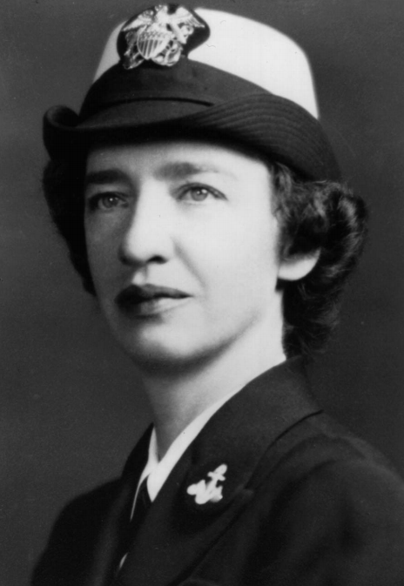
Let’s talk about the work of this lady, Grace Murray Hopper (and her team)

Slide 19
She had a PhD in Mathematics, served in the Navy during WWII and created several programming languages in the 50’s, as a director at the Rand Corporation

Slide 20
COBOL (Common Business-Oriented Language) came from a desire to write a programming language that was more like English and less like Assembly.

Slide 21
You might see a theme…
FORTRAN – for science
ALGOL – for algorithms
COBOL – for business
This was thought to be the “right pattern” for many years – to develop a new programming language for each type of problem that needed to be solved.

Slide 22
IDENTIFICATION DIVISION.
PROGRAM-ID. StudentNumbersReport .
AUTHOR. Michael Coughlan.
ENVIRONMENT DIVISION.
INPUT-OUTPUT SECTION.
FILE-CONTROL.
SELECT StudentFile ASSIGN TO "STUDENTS.DAT"
ORGANIZATION IS LINE SEQUENTIAL.
SELECT ReportFile ASSIGN TO "STUDENTS.RPT"
ORGANIZATION IS LINE SEQUENTIAL.

Slide 23
DATA DIVISION.
FILE SECTION.
FD StudentFile.
01 StudentDetails.
88 EndOfStudentFile VALUE HIGH-VALUES.
02 StudentId PIC 9(7).
02 StudentName.
03 Surname PIC X(8).
03 Initials PIC XX.
02 DateOfBirth.
03 YOBirth PIC 9(4).
03 MOBirth PIC 9(2).
03 DOBirth PIC 9(2).
02 CourseCode PIC X(4).
02 Gender PIC X.
88 Male VALUE "M", "m".
FD ReportFile.
01 PrintLine PIC X(40).

Slide 24
WORKING-STORAGE SECTION.
01 HeadingLine PIC X(21) VALUE " Record Count Report".
01 StudentTotalLine.
02 FILLER PIC X(17) VALUE "Total Students = ".
02 PrnStudentCount PIC Z,ZZ9.
01 MaleTotalLine.
02 FILLER PIC X(17) VALUE "Total Males = ".
02 PrnMaleCount PIC Z,ZZ9.
01 FemaleTotalLine.
02 FILLER PIC X(17) VALUE "Total Females = ".
02 PrnFemaleCount PIC Z,ZZ9.
01 WorkTotals.
02 StudentCount PIC 9(4) VALUE ZERO.
02 MaleCount PIC 9(4) VALUE ZERO.
02 FemaleCount PIC 9(4) VALUE ZERO.

Slide 25
PROCEDURE DIVISION.
Begin.
OPEN INPUT StudentFile
OPEN OUTPUT ReportFile
READ StudentFile
AT END SET EndOfStudentFile TO TRUE
END-READ
PERFORM UNTIL EndOfStudentFile
ADD 1 TO StudentCount
IF Male ADD 1 TO MaleCount
ELSE ADD 1 TO FemaleCount
END-IF
READ StudentFile
AT END SET EndOfStudentFile TO TRUE
END-READ
END-PERFORM
PERFORM PrintReportLines
CLOSE StudentFile, ReportFile
STOP RUN.

Slide 26
PrintReportLines.
MOVE StudentCount TO PrnStudentCount
MOVE MaleCount TO PrnMaleCount
MOVE FemaleCount TO PrnFemaleCount
WRITE PrintLine FROM HeadingLine
AFTER ADVANCING PAGE
WRITE PrintLine FROM StudentTotalLine
AFTER ADVANCING 2 LINES
WRITE PrintLine FROM MaleTotalLine
AFTER ADVANCING 2 LINES
WRITE PrintLine FROM FemaleTotalLine
AFTER ADVANCING 2 LINES.

Slide 27
Yes, Cobol is very wordy.

Slide 28
Positives of COBOL
Very easy to do structured I/O, including reports
Reads like (very formal, stilted) English – self documents
Not Assembly, but still fast to compile & run
Not tied to 1 computer architecture (like Assembly)
Good number handling – rounding and overflows
Supports a semi-database format natively

Slide 29
Criticisms of Cobol
Hard to break programs up into useful modules
Many implementation, many incompatible versions
- This was common with other languages too
Verbose
Not very “computer science” – very business
Feels very “50’s” – divisions and sections
Lack of scoping – too many variables are global

Slide 30
A Hint of the flavor - BASIC
Designed by John Kemeny and Thomas Kurtz at Darmouth (1963)
Intended for beginners to learn programming, this ran on a machine that many people could use at once.
Each line of code was numbered and you could jump to a line by referencing its line number.

Slide 31
10 PRINT “ROOT OF FUNCTION.”
20 PRINT “FUNC IS - AT 0 AND + AT 1”
30 DEF FNF(Z) = Z^5 + Z^3 -1
40 LET X=0
50 LET D=.5
60 LET Y=FNF(X)
70 IF Y=0 THEN 200
80 IF Y>0 THEN 150
90 LET X=X<>D
100 GOTO 160
150 LET X = X – D
160 IF D < .0001 THEN 200
170 LET D=D/2
180 GO TO 60
200 PRINT “ROOT = “ X
999 END

Slide 32
A hint of the flavor – Pascal (1968-1972)
Designed by Niklaus Wirth, a Swiss computer scientist. We wanted to simplify ALGOL and focus on education.
Simple highly structured conditionals and loops
The ability to make enumerations
More data structures (records, files, sets)
Included pointers
Used “P-Code” – a stack based virtual machine

Slide 33
Program TowersOfHanoi(input,output);
Var
disks: integer;
Procedure Hanoi(source, temp, destination: char; n: integer);
begin
if n > 0 then
begin
Hanoi(source, destination, temp, n - 1);
writeln('Move disk ',n:1,' from peg ',source,' to peg ',destination);
Hanoi(temp, source, destination, n - 1);
end;
end;
begin
write('Enter the number of disks: ');
readln(disks);
writeln('Solution:');
Hanoi('A','B','C',disks);
end.

Slide 34
C, Shell, UNIX
The C programming language, the Bash (and other) shell language and UNIX all came from Bell Labs in the early 1970’s. These are so critical to our understanding of Computer Science that they get their own course.
Of all of the procedural programming languages, C is, by far, the most popular today. It is highly portable and is particularly designed for “systems programming” – writing operating systems and other low level software.

Slide 35
/* add.c
* a simple C program
*/
#include <stdio.h>
#define LAST 10
int main()
{
int i, sum = 0;
for ( i = 1; i <= LAST; i++ ) {
sum += i;
} /*-for-*/
printf("sum = %d\n", sum);
return 0;
}

Slide 36
Many more
There are literally hundreds, maybe thousands of procedural languages that we have not discussed here. Writing a compiler used to be considered a very typical activity for a computer scientist.
Procedural languages moved Computer Science forward immensely and serve as the backbone for many of our critical infrastructure pieces. Every mainstream operating system and embedded device use a procedural language, even today.

Slide 37
Criticisms of Procedural Languages
Often, grouping of functions/procedures is lacking; you can see your program as a “sea of functions”.
All variables are local or global.
Generics are not typically found in procedural languages
Are often lower level and require some machine level knowledge (pointers, for example)

Slide 38
“The real issue”
Procedural programs, like assembly language programs before them, do not scale. Each successive paradigm lets us build bigger programs more successfully.
In assembly, anything more than 500 or so lines gets too big to hold in your head.
Procedural programs of a few thousand lines are reasonable.
In Object Oriented programming, you can write programs in the tens or hundreds of thousands of lines reasonably.

